Slide 1
Retrieval – Project Analysis feedback
What Went Well
Following the mark scheme
All students followed the mark scheme when completing their work. This is a really important to do as some students often completed pages of work that don’t actually meet the requirements of the mark scheme.
Gathering stakeholder information
Lots of students really described and justified in detail how their proposed stakeholders would make sure of their project.
Points to consider!
Act on feedback provided – Make sure to amend your project and re-submit your work if necessary for checking to make sure you are now hitting the higher bounds of the mark scheme. If you do it now, it will save you time in the long run.
OCR Proposal feedback – Please read this, OCR have provided us with whole class and individual feedback.
Unity coding – Unity can provide a lot of code for you, please be aware of this.
Multi-player/AI – Make sure that your game is either multiplayer or against the PC in some way.
Always look at the higher band on the mark sheet – Aim high, always look at the top band and make sure your work meets the requirements.
Use the example projects from previous students but… don’t copy them.
Please use headings in word.
Even Better If
Discussing limitations to the project was not done in detail in most cases. Students need to consider all limitations such as time constraints, knowledge, hardware and software as well as stakeholder issues such as not being able to be in regular contact.
Justification Is always an issue when writing the project. Why have you chosen to do it this way. Refer to research and stakeholder interviews etc.

Slide 2
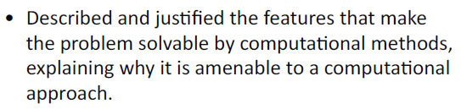
Require– Project Analysis Mark scheme
You need to cover all/most of the 5 computational thinking strands that are set out in the specification and which we cover in Unit 2:
Thinking Abstractly – How does your project use abstraction?
Thinking Ahead – Identifying simple inputs and outputs and reusable programming concepts.
Thinking Procedurally – Identifying the components. Design a basic top down structure diagram.
Thinking Logically – Do decisions need to be made in the program.
Thinking concurrently – Are there parts of a problem that happen at the same time?

Slide 3
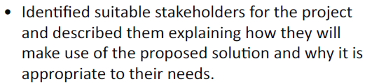
Require– Project Analysis Mark scheme
You don’t need lots of stakeholders. One is perfectly ok. You will be creating more work for yourself when implementing your project as you will need to go to them for their opinion each time you do an iteration.
You need to emphasise how they will make use of the solution. “ I have chosen Miss Page because she is a Computer Science teacher and therefore has a keen interest in the field. She will be able to use this program to engage students in learning within the classroom. I can also share with her prototypes during development for feedback”
Interviews are good, but make sure you refer to them when detailing features of your system so that they are not a waste and ask the right questions.
Make sure to write a short summary of your interview, this could be where you follow in with essential features.

Slide 4
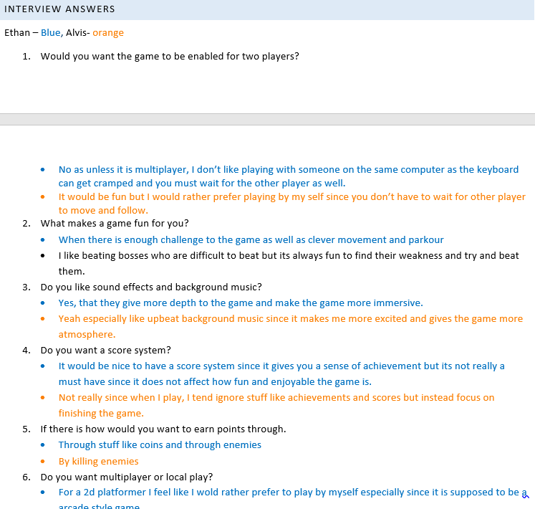
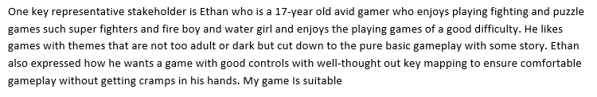
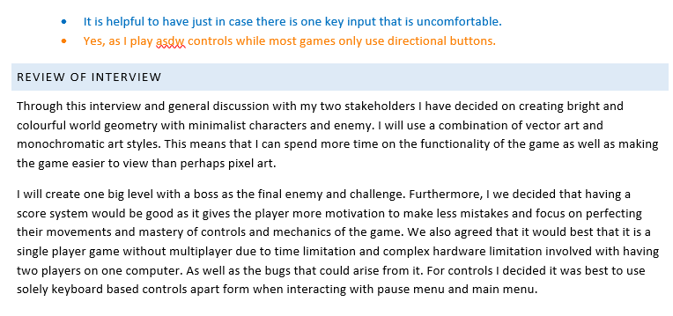

Slide 5
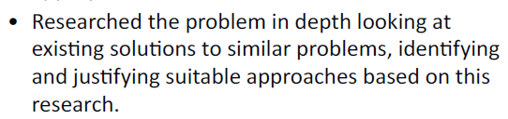
Require– Project Analysis Mark scheme
Research a minimum of two similar solutions.
Label screenshots if you can.
Make a table of features of the game that you will/won’t be including in your project.
Justify why you are going to include this in your solution.

Slide 6
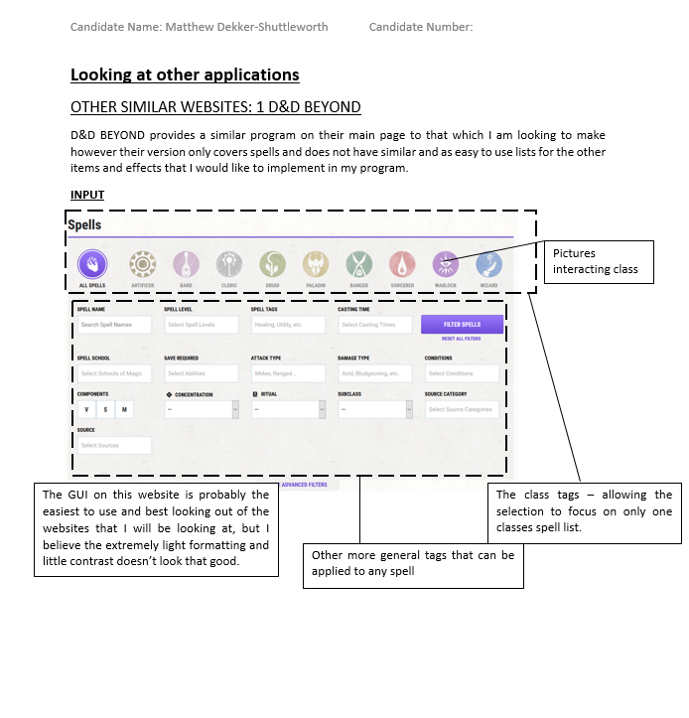
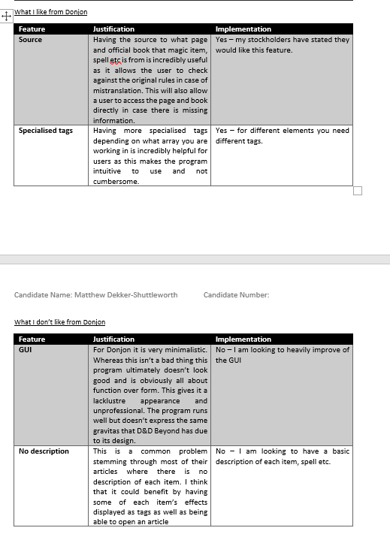

Slide 7

Require– Project Analysis Mark scheme
This is not a success criteria.
The best way to do this is with a table of features your proposed solution should include.
You can also do an additional table of features that might be implemented based on limitations.
Your table should include features, description and justification.
Reference research and stakeholder interviews to justify why this is included.

Slide 8
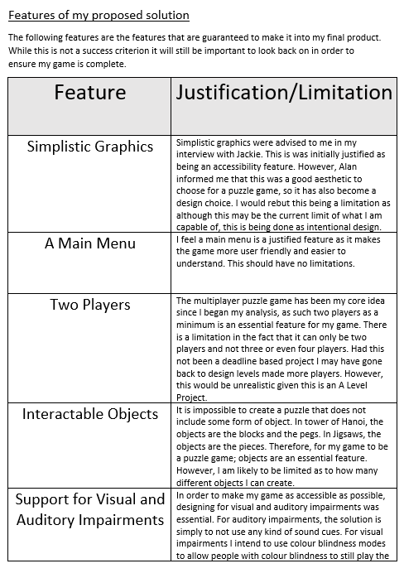

Slide 9

Require– Project Analysis Mark scheme
Any limitations you may come across i.e time, hardware, software, stakeholders, knowledge etc.
You need to explain and justify why these are issues.
Doesn’t need to be a long section.
Make subheadings for the issues.

Slide 10
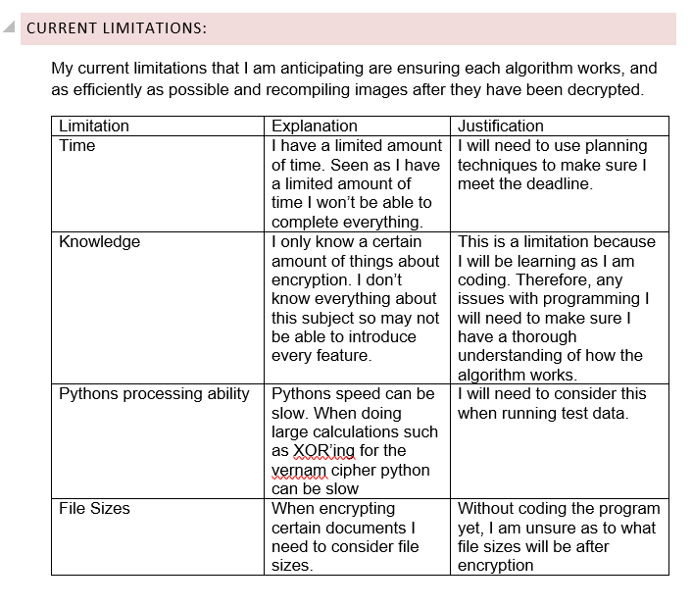

Slide 11

Require– Project Analysis Mark scheme
Just like what you see when purchasing a game or piece of software, list the requirements of the proposal. Focus on what you need to develop for the project and also what you propose the end user will need after development.
You need to justify why these are requirements, not just “1gb RAM because all computers need RAM”.
It is best to do this in a table with headings: Requirement, description and justification.

Slide 12
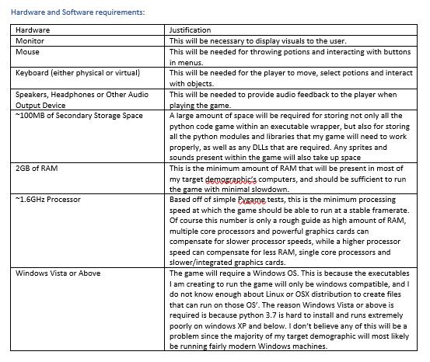

Slide 13

Require– Project Analysis Mark scheme
Key word here is measurable.
You need to make a list of criteria from your proposed solution that will make it successful and these points need to be able to be measured. They cannot be vague.
In the evaluation you will be cross-referencing your success criteria from your analysis and showing evidence of how it has been met/partially met/unmet.
Must include at least 8-10 criteria points.

Slide 14
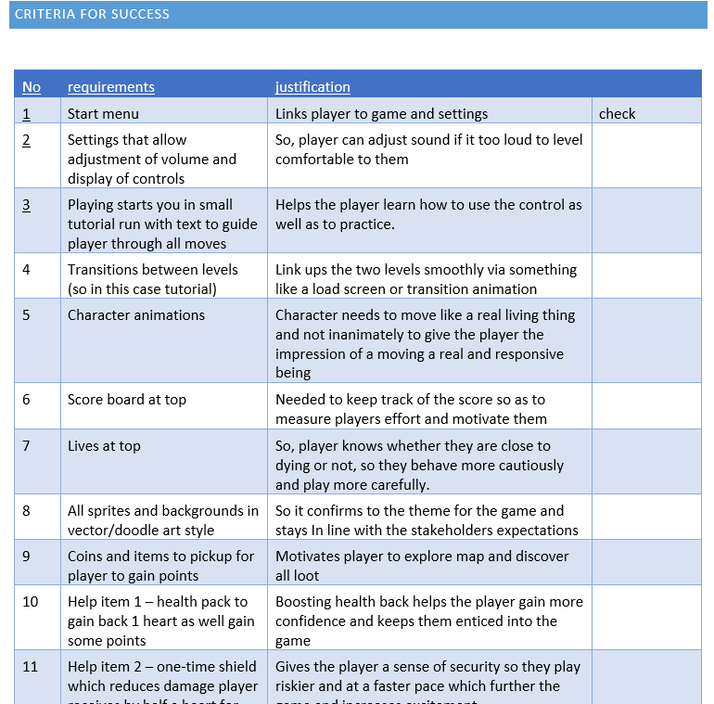

Slide 15
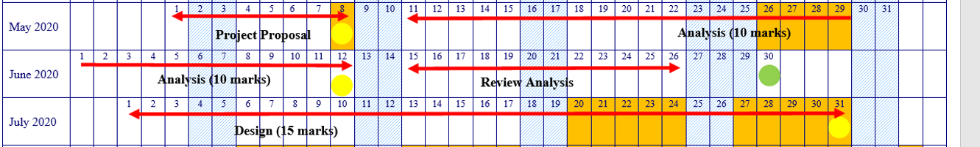
Action – Review feedback
You have until 30th June (end of the month) to make any changes and submit them for review.
After this, you will need to move onto the Design section.

Slide 16
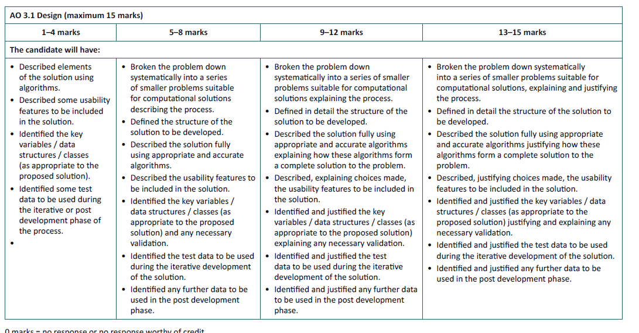
Review

Slide 17
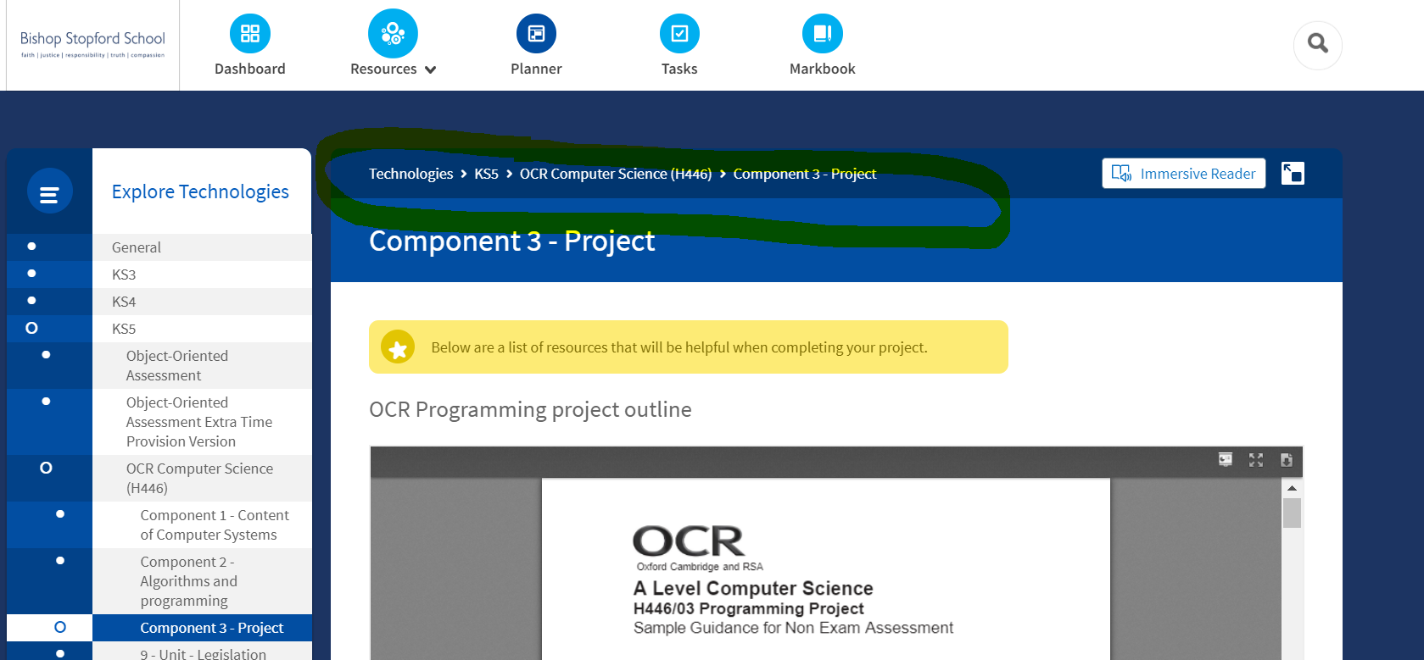
Review

Slide 18
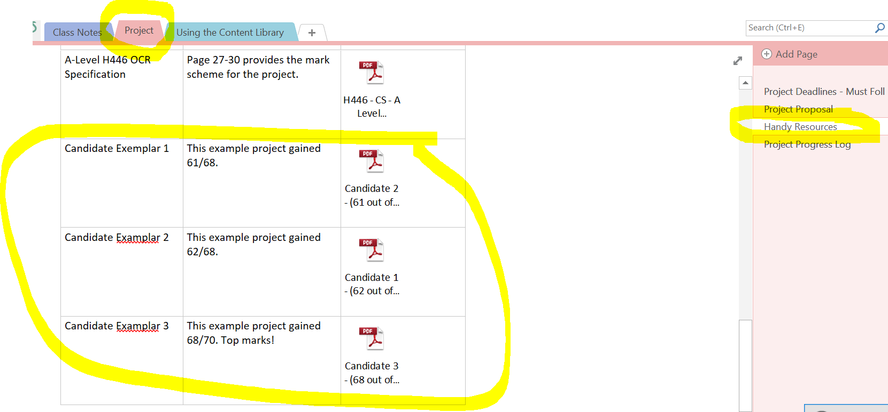
Review

Slide 19
Other
Project work and theory work should only be uploaded to Firefly at the moment.
Please email me if you are struggling to complete work or you are unsure about a topic that we are covering.
It is important to keep communication going.

